Slide 1
Dr. Yifeng Zhu Electrical and Computer Engineering University of Maine
Embedded Systems
Lab 2
Analog-to-Digital Converter (ADC)
Fall 2019

Slide 2
Analog-to-Digital Converter (ADC)
ADC is important almost to all application fields
Converts a continuous-time voltage signal within a given range to discrete-time digital values to quantify the voltage’s amplitudes
x(t)
x(n)
ADC
quantize
continuous-time analog signal
discrete-time digital values

Slide 3
Analog-to-Digital Converter (ADC)
Three performance parameters:
sampling rate
resolution
power dissipation
Many ADC implementations:
sigma-delta
successive-approximation
pipeline

Slide 4

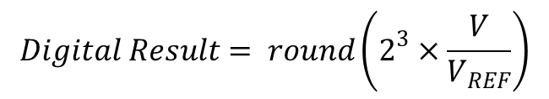
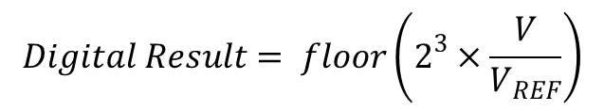
Resolution
Resolution is determined by number of bits (in binary) to represent an analog input.
Example of two quantization methods (N = 3)
Δ
½ Δ
$$Digital Result= floor\left(2^{3}×\frac{V}{V_{REF}}\right)$$
$$Digital Result= round\left(2^{3}×\frac{V}{V_{REF}}\right)$$
Max quantization error = Δ = V_{REF}/2³
Max quantization error = ±½ Δ = ±V_{REF}/2⁴
$$round\left(x\right)=floor(x+0.5)$$

Slide 5
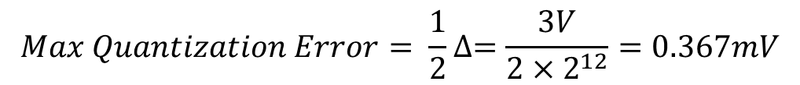
Quantization Error
For N-bit ADC, it is limited to ±½Δ
Δ = is the step size of the converter.
Example: for 12-bit ADC and input voltage range [0, 3V]
Δ
$$Max Quantization Error= \frac{1}{2}∆=\frac{3V}{2×2^{12}}=0.367mV$$

Slide 6
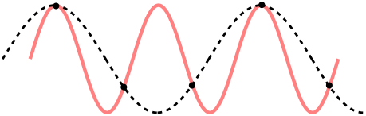
Minimum Sampling Rate: Nyquist–Shannon Sampling Theorem
In order to be able to reconstruct the analog input signal, the sampling rate should be at least twice the maximum frequency component contained in the input signal
Example of two sine waves have the same sampling values. This is called aliasing.
from wiki.com
Antialiasing (beyond the scope of this course)
Pre-filtering: use analog hardware to filtering out high-frequency components and only sampling the low-frequency components. The high-frequency components are ignored.
Post-filtering: Oversample continuous signal, then use software to filter out high-frequency components

Slide 7
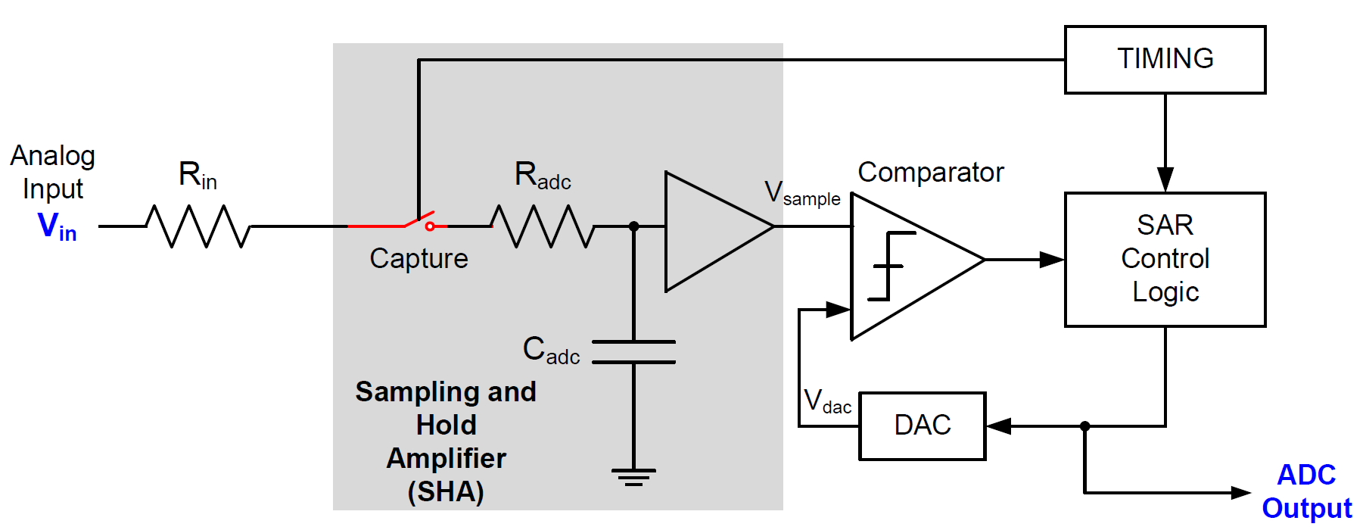
Successive-approximation (SAR) ADC

Slide 8

Determining Minimum Sampling Time
$$V_{C}\left(t\right)=V_{in}×(1−e^{−\frac{t}{T_{c}}})$$
Sampling time is software programmable!
Smaller sampling error
Larger sampling time
Tradeoff
Slower ADC speed

Slide 9
Programming ADC Sampling Time
4 cycles
HSI Clock
ADC Clock
9 cycles
Prescaler
/1, /2, /4
16 cycles
16 MHz
24 cycles
Selection
default prescaler = 1
48 cycles
96 cycles
192 cycles
384 cycles
ADC sample time register (SMPR)

Slide 10
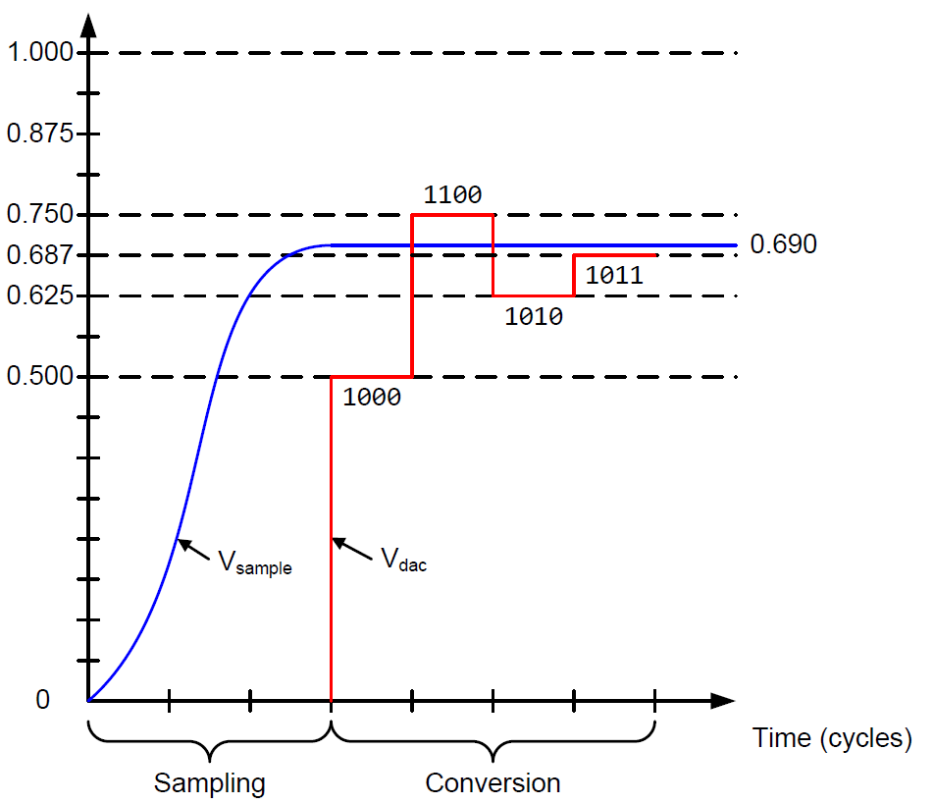



Successive-approximation (SAR) ADC
Binary search algorithm to gradually approaches the input voltage
Settle into ±½ LSB bound within the time allowed
$$T_{ADC}=T_{sampling}+T_{Conversion}$$
$$T_{Conversion}=N×T_{ADC_Clock}$$
$$T_{sampling}$$
is software configurable

Slide 11



ADC Conversion Time
$$T_{ADC}=T_{sampling}+T_{Conversion}$$
Suppose ADCCLK = 16 MHz and Sampling time = 4 cycles
For 12-bit ADC
$$T_{ADC}=4+12=16 cycles=1μs$$
For 6-bit ADC
$$T_{ADC}=4+6=10 cycles=625ns$$

Slide 12
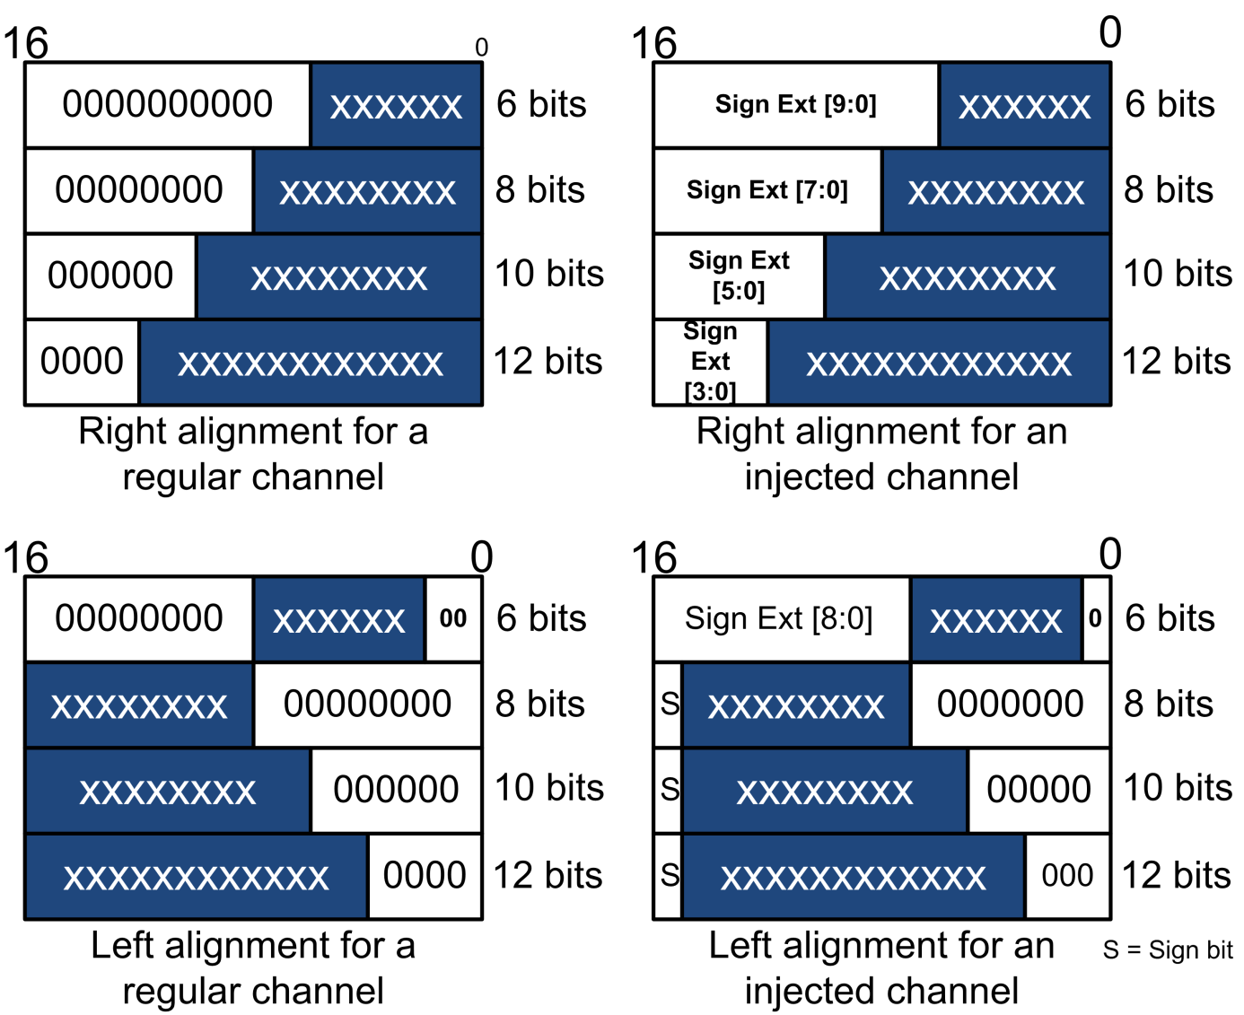
Data Alignment

Slide 13
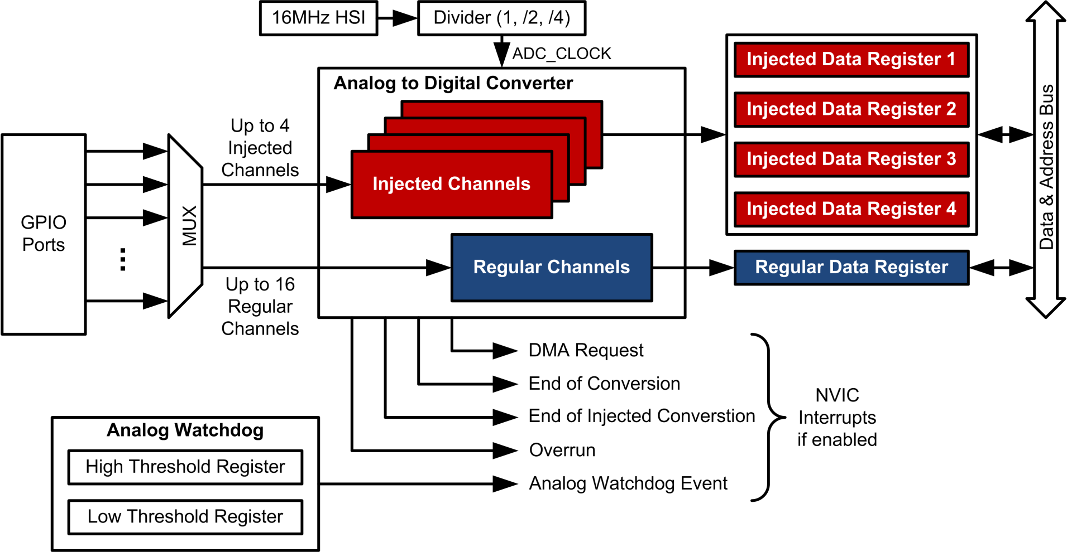
ADC: Regular vs injected

Slide 14
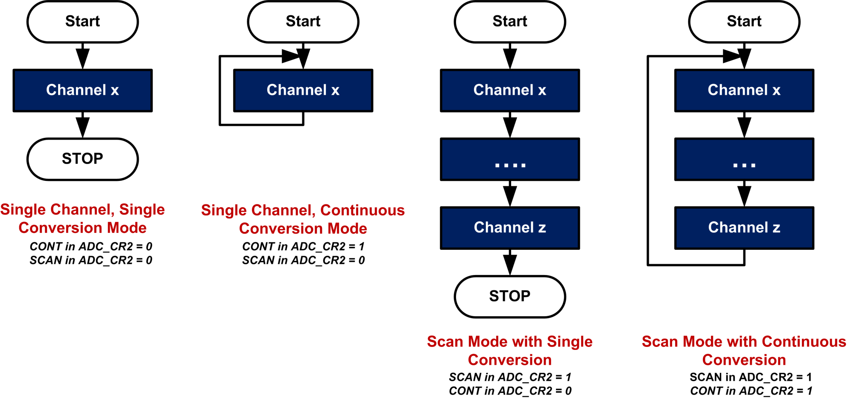
ADC Mode

Slide 15
ADC Mode
Regular channel:
Set SWSTART in ADC_CR2
The channel is selected by SQ1[4:0] in SQR5
Result is stored in ADC_DR
EOC is set after conversion
Interrupt is generated if EOCIE is set
Injected channel:
Set JSWSTART in ADC_CR2
The channel is selected by JSQ1[4:0] in JSQR
Result is stored in ADC_JDR1
JEOC is set after conversion
Interrupt is generated if JEOCIE is set

Slide 16
ADC Mode
Channels are selected by ADC_SQRx registers for regular channels, and by ADC_JSQR register for injected channel
All channels in a regular group share the same result register ADC_DR. Make sure to read data between consecutive sampling.

Slide 17

V_{REF}
Some chips does not expose V_{REF} to a pin
STM32L LQFP64 does not have V_{REF} pin
STM32L LQFP100 does
Infer internal V_{REF}
How?
Corresponds to $\frac{2^{n}−1}{2^{n}}V_{REF}$

Slide 18
Analog Watchdog
Analog voltage
Two programmable thresholds
Higher threshold (HTR)
Guarded Area
Lower threshold (LTR)
If V < V_{LTR} or V > V_{HTR}, the analog watchdog (AWD) flag (in ADC Status Register) is set, generating an interrupt to the processor
The monitor is automatically performed by hardware, not software
Convenient and efficient feature
Help processor detect exceptions and recover from specific situations
For example, monitor sensor data and raise alarm on some level.

Slide 19
Example: ADC with Timer Interrupts
Main program
Set up timer
ADC interrupt
timer interrupt
Timer
Peripheral
ADC
Peripheral
Timer ISR
Wait for DAC_Done = 1
Set ADC_Done flag
ADC ISR
Process Data
ISR = Interrupt Service Routine
TIMER ISR starts ADC
ADC samples multiple channels
ADC ISR copies ADC data register to memory
Repeat

Slide 20
Example: ADC with Timer and DMA
Main program
Set up DMA
Set up timer
timer interrupt
sampling
channels
DMA
Controller
Timer
Peripheral
ADC
Peripheral
Timer ISR
Wait for DMA_Done = 1
Set DMA_Done flag
Process Data
Timer ISR starts ADC and DMA
DMA automatically copies ADC results of multiple channels to memory after each conversion
Repeat

